Slide 1
Intercultural Trends in the Euro-Med Region
Country results: Morocco

Slide 2
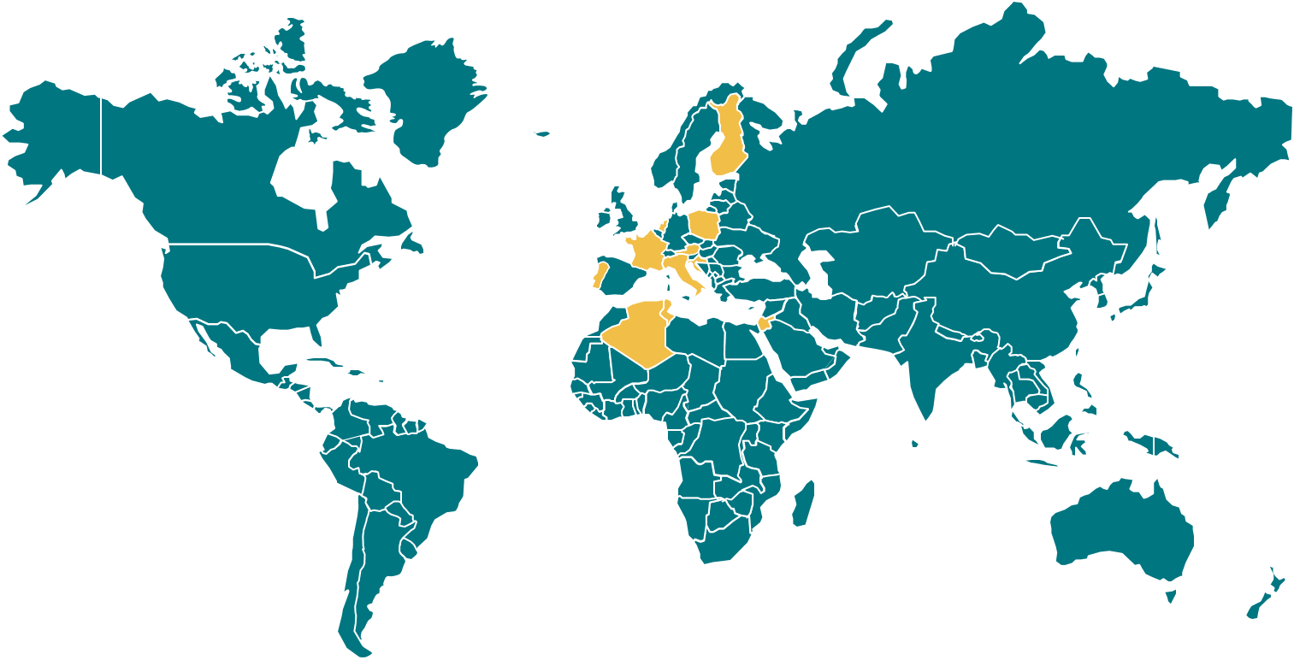
Methodological note
The Anna Lindh Foundation commissioned Ipsos to undertake its third opinion poll to measure intercultural trends in the Euro-Mediterranean Region.
The opinion poll was carried out in eight European countries (Croatia, Cyprus, Czechia, Germany, Greece, Ireland, Romania, Sweden) and five SEM countries/territories (Algeria, Jordan, Lebanon, Mauritania, Morocco).
The target population consists of all individuals aged 15 or older (16 in Czechia and Sweden), resident in each of the countries covered. In all countries, the target sample size was 1,000 fully-completed interviews. Fieldwork for all countries bar Mauritania took place between 9 March 2020 and 16 June 2020, with a suspension of fieldwork part-way through due to the COVID-19 pandemic. Fieldwork in Mauritania took place between 28 August 2020 and 09 October 2020.
In all countries, a CATI (Computer Assisted Telephone Interviewing) methodology was implemented. Random probability sampling was used in all countries except Mauritania, where quota sampling was used.
All findings presented are based on weighted data. A post-stratification weight was calculated that corrects for imbalances in the samples with respect to gender, age and activity status. Where the percentages provided do not add up to or exceed 100%, this may be due to rounding.

Slide 3
Representation of the Mediterranean region

Slide 4
Characteristics of the Mediterranean region
Survey question: Different people have different thoughts about what the Mediterranean region represents. I will read out a set of ideas and images; please tell me if you think these characterise the Mediterranean region strongly, somewhat or not at all.
Base: all respondents (%), by country and country group

Slide 5
Characteristics of the Mediterranean region
Survey question: Different people have different thoughts about what the Mediterranean region represents. I will read out a set of ideas and images; please tell me if you think these characterise the Mediterranean region strongly, somewhat or not at all.
Base: all respondents (%), by country

Slide 6
Preferred countries to start a new life
Survey question: If you could start a new life, in which country of the world would you start it?
Base: all respondents (%), by country and country group

Slide 7
Values and mutual perceptions

Slide 8
Key values when raising children
Survey question: In bringing up their children, parents in different countries may place different emphasis on different values. Assuming that we limit ourselves to six values only, I’d like to know which one of these is most important, to you personally, when raising children? And the second most important?
Base: all respondents (%), by country and country group

Slide 9
Key values when raising children
Perceptions about key values for parents raising children in European countries
Perceptions in Morocco about key values of parents in:
&
Survey question: In bringing up their children, parents in different countries may place different emphasis on different values. Assuming that we limit ourselves to six values only, I’d like to know which one of these is most important, to you personally, when raising children? And the second most important?
And which one of these six do you think is most important to parents raising children in Europe? And the second most important?
Base: all respondents (%), by country and country group

Slide 10
Key values when raising children
Survey question: In bringing up their children, parents in different countries may place different emphasis on different values. Assuming that we limit ourselves to six values only, I’d like to know which one of these is most important, to you personally, when raising children? And the second most important?
Base: all respondents (%), by country

Slide 11
Perceptions about women’s roles in society
Should women be playing a greater role?
Women’s role in:
Survey question: Compared to their present role in your country, do you think that women should be playing a greater, the same, or lesser role in each of the following domains:
Base: all respondents (%), by country and country group

Slide 12
Cross-cultural media reporting

Slide 13
Interest in news and information about SEM/European countries
Survey question: Thinking about the countries bordering the southern and eastern shore of the Mediterranean Sea (asked in European countries)/European countries (asked in SEM countries), how interested are you in knowing about their:
Base: all respondents (%), by country and country group

Slide 14
Interest in news and information about SEM/European countries
Survey question: Thinking about the countries bordering the southern and eastern shore of the Mediterranean Sea (asked in European countries)/European countries (asked in SEM countries), how interested are you in knowing about their:
Base: all respondents (%), by country and country group

Slide 15
Media role in shaping public perception
Did media cause a change in views about people from SEM/European countries?
Survey question: During the past 12 months, have you seen, read or heard anything in the media that has influenced your view of people in countries bordering the southern and eastern shore of the Mediterranean Sea (asked in European countries)/European countries (asked in SEM countries)
Base: all respondents (%), by country and country group

Slide 16
Most trusted media sources for cross-cultural reporting
Survey question: Which of the following sources do you trust most for information about countries bordering the southern and eastern shore of the Mediterranean Sea (asked in European countries)/European countries (asked in SEM countries)?
Base: all respondents (%), by country and country group

Slide 17
Interaction and dialogue

Slide 18
Interactions with people from different countries
82
Survey question: In the past 12 months, have you talked to or met someone from a country bordering the southern and eastern shore of the Mediterranean Sea (asked in European countries)/a European country (asked in SEM countries)? (top bar in the chart)
Do you have any relatives or friends who live in countries bordering the southern and eastern shore of the Mediterranean Sea (asked in European countries)/European countries (asked in SEM countries)? (bottom bar)
Base: all respondents (%), by country and country group

Slide 19
Cross-cultural encounters
Method of interaction
Survey question: Thinking of this/these person(s) you have interacted with, was this mainly through:
Base: respondents who have talked to or met someone from a SEM/European country in the past 12 months (%), by country and country group

Slide 20

Interactions with people from different countries
Due to differences in question wording, caution should be exercised when comparing the 2020/2016 and 2012 results.
Survey question (2020 and 2016): In the past 12 months, have you talked to or met someone from a country bordering the southern and eastern shore of the Mediterranean Sea (asked in European countries)/a European country (asked in SEM countries)? Thinking of this/these person(s) you have interacted with, was this mainly through:
Survey question (2012): In the last 12 months have you personally talked to or met with any person (or persons) from countries bordering the southern and eastern shore of the Mediterranean Sea (asked in European countries)/European countries (asked in SEM countries)? How did you meet or talk to that person?
Base: all respondents (left-hand chart) and respondents who have talked to or met someone from a SEM/European country in the past 12 months (right-hand chart) (%), by country

Slide 21
Cross-cultural encounters
Did meeting people from SEM/European countries cause a change in views?
Survey question: Thinking of your encounter(s) with this/these person(s), did meeting or talking to them change or reinforce your view of people from countries bordering the southern and eastern shore of the Mediterranean Sea (asked in European countries)/European countries (asked in SEM countries)?
Base: respondents who have talked to or met someone from a SEM/European country in the past 12 months (%), by country and country group

Slide 22
Barriers to cross-cultural encounters
Survey question: To what extent, if at all, are each of the following a barrier, when meeting with or talking to people from different cultures?
[share who say it is “a big barrier” or “somewhat of a barrier”]
Base: all respondents (%), by country and country group

Slide 23
Living together in multi-cultural environments

Slide 24
Perceptions about religious and cultural diversity
Survey question: How much do you agree or disagree with the following statements?
Base: all respondents (%), by country and country group

Slide 25
Perceptions about religious and cultural diversity
Survey question: How much do you agree or disagree with the following statements?
*In 2012, question wording referred to having the same right and opportunities to participate in public life, meaning the results are not directly comparable.
Base: all respondents (%), by country

Slide 26
Cultural diversity and tolerance
Would you mind:
Survey question: I am now going to read out a number of scenarios. For each of them, please tell me whether you would mind a lot, mind a little, or whether you would not mind too much, or not mind at all.
Base: all respondents (%), by country and country group

Slide 27
Living together in multicultural environments
Actions that can help people live better together
Survey question: Today’s societies are becoming more and more diverse as a result of migration. How efficient do you think that each of the following actions would be in helping people live better together in a multi-cultural environment?
Base: all respondents (%), by country and country group

Slide 28
Tackling polarisation and hate speech
Preventing and dealing with challenges such as hate speech and polarisation
Survey question: Many countries, in Europe and in the countries on the southern and eastern Mediterranean shores, are facing challenges, such as hate speech and opposing cultural views. How effective do you think that each of the following will be in preventing and dealing with these challenges?
Base: all respondents (%), by country and country group

Slide 29
Gains from Euro-Med cooperation

Slide 30
Gains from Euro-Med cooperation
Survey question: Your country, with other European/SEM countries, has decided to reinforce closer cooperation with SEM/European countries. Which of the following do you think your society can gain by reinforcing such cooperation?
Base: all respondents (%), by country and country group

Slide 31
Gains from Euro-Med cooperation
Due to substantial differences in question wording, caution should be exercises when comparing the 2016 and 2012 results.
Survey question (2020): Your country, along with other countries bordering the southern and eastern shore of the Mediterranean Sea, has decided to reinforce closer cooperation with European countries. Which of the following do you think your society can improve by reinforcing such cooperation?
Survey question (2016): Your country, with other European/SEM countries, has decided to reinforce closer cooperation with SEM/European countries in the framework of the European Neighbourhood Policy. Which of the following do you think your society can gain by reinforcing such cooperation?
Survey question (2012): Your country, with other European countries and the countries on the southern and eastern shore of the Mediterranean, has decided to establish closer political, economic and cultural exchanges, within a project called “Union for the Mediterranean.” Which of these aspects do you think your society can gain from such a shared project?
Base: all respondents (%), by country

Slide 32
Impact of digital technology

Slide 33
Impact of digital technology
Survey question: With regard to the use of digital technology, please tell me to what extent you agree or disagree with each of the following statements:
Base: all respondents (%), by country and country group

Slide 34
Demographic profile of the samples

Slide 35
Demographic profile
 |  | Morocco (n=1,020) | European countries (n=8,171) | SEM countries (n=5,093)
Gender | Men | 51% | 48% | 51%
 | Women | 49% | 51% | 49%
Age | 15-29 | 36% | 19% | 40%
 | 30-49 | 41% | 32% | 38%
 | 50-64 | 16% | 25% | 15%
 | 65+ | 5% | 23% | 5%
 | DK/REF | 2% | 1% | 2%
Activity status | Economically active | 45% | 57% | 42%
 | Not currently in paid work | 55% | 41% | 58%
 | DK/REF | 0% | 2% | 0%
Level of education | Primary education or less | 62% | 8% | 38%
 | Secondary or post-secondary non-tertiary education | 13% | 49% | 31%
 | University-level education | 26% | 41% | 31%
Religion | Roman Catholic | 0% | 18% | 1%
 | Protestant | 0% | 18% | 0%
 | Muslim | 90% | 2% | 93%
 | Jewish | 0% | 0% | < 1%
 | Other | 0% | 19% | 1%
 | Unaffiliated | 9% | 35% | 4%
This table compares the sample profiles (after weighting) by country and country group. A post-stratification weight was applied that corrects for imbalances in the samples with respect to gender, age and activity status. Note: in Jordan, no questions were asked about religion

Slide 36
Femke De Keulenaer
Research director, Ipsos SRI
+32 2 642 48 60
+32 485 18 23 50
femke.dekeulenaer@ipsos.com

