Slide 1
Intercultural Trends in the Euro-Med Region
Country results: Romania

Slide 2
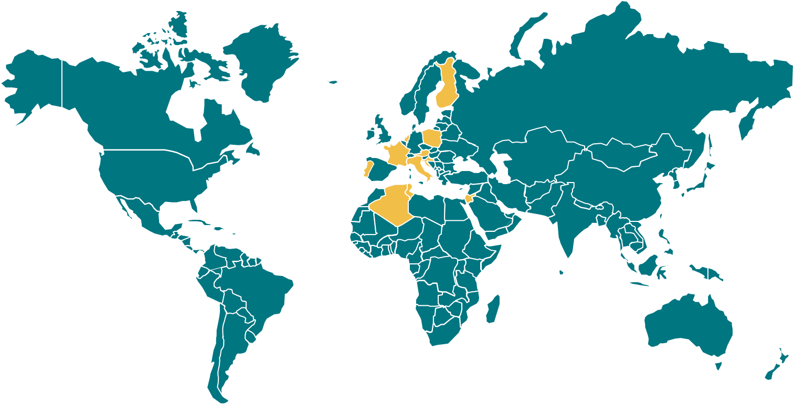
Methodological note
The Anna Lindh Foundation commissioned Ipsos to undertake its third opinion poll to measure intercultural trends in the Euro-Mediterranean Region.
The opinion poll was carried out in eight European countries (Croatia, Cyprus, Czechia, Germany, Greece, Ireland, Romania, Sweden) and five SEM countries/territories (Algeria, Jordan, Lebanon, Mauritania, Morocco).
The target population consists of all individuals aged 15 or older (16 in Czechia and Sweden), resident in each of the countries covered. In all countries, the target sample size was 1,000 fully-completed interviews. Fieldwork for all countries bar Mauritania took place between 9 March 2020 and 16 June 2020, with a suspension of fieldwork part-way through due to the COVID-19 pandemic. Fieldwork in Mauritania took place between 28 August 2020 and 09 October 2020.
In all countries, a CATI (Computer Assisted Telephone Interviewing) methodology was implemented. Random probability sampling was used in all countries except Mauritania, where quota sampling was used.
All findings presented are based on weighted data. A post-stratification weight was calculated that corrects for imbalances in the samples with respect to gender, age and activity status. Where the percentages provided do not add up to or exceed 100%, this may be due to rounding.

Slide 3
Representation of the Mediterranean region

Slide 4
Characteristics of the Mediterranean region
Survey question: Different people have different thoughts about what the Mediterranean region represents. I will read out a set of ideas and images; please tell me if you think these characterise the Mediterranean region strongly, somewhat or not at all.
Base: all respondents (%), by country and country group

Slide 5
Preferred countries to start a new life
Survey question: If you could start a new life, in which country of the world would you start it?
Base: all respondents (%), by country and country group

Slide 6
Values and mutual perceptions

Slide 7
Key values when raising children
Survey question: In bringing up their children, parents in different countries may place different emphasis on different values. Assuming that we limit ourselves to six values only, I’d like to know which one of these is most important, to you personally, when raising children? And the second most important?
Base: all respondents (%), by country and country group

Slide 8
Key values when raising children
Perceptions about key values for parents raising children in Europe
Perceptions in Romania about key values of parents in:
&
Survey question: In bringing up their children, parents in different countries may place different emphasis on different values. Assuming that we limit ourselves to six values only, I’d like to know which one of these is most important, to you personally, when raising children? And the second most important?
And which one of these six do you think is most important to parents raising children in Europe? And the second most important?
Base: all respondents (%), by country and country group

Slide 9
Perceptions about women’s roles in society
Should women be playing a greater role?
Women’s role in:
Survey question: Compared to their present role in your country, do you think that women should be playing a greater, the same, or lesser role in each of the following domains:
Base: all respondents (%), by country and country group

Slide 10
Cross-cultural media reporting

Slide 11
Interest in SEM/European countries
Survey question: Thinking about the countries bordering the southern and eastern shore of the Mediterranean Sea (asked in European countries)/European countries (asked in SEM countries), how interested are you in knowing about their:
Base: all respondents (%), by country and country group

Slide 12
Media role in shaping public perception
Did media cause a change in views about people from SEM/European countries?
Survey question: During the past 12 months, have you seen, read or heard anything in the media that has influenced your view of people in countries bordering the southern and eastern shore of the Mediterranean Sea (asked in European countries)/European countries (asked in SEM countries)
Base: all respondents (%), by country and country group

Slide 13
Most trusted media sources for cross-cultural reporting
Survey question: Which of the following sources do you trust most for information about countries bordering the southern and eastern shore of the Mediterranean Sea (asked in European countries)/European countries (asked in SEM countries)?
Base: all respondents (%), by country and country group

Slide 14
Interaction and dialogue

Slide 15
Interactions with people from different countries
82
Survey question: In the past 12 months, have you talked to or met someone from a country bordering the southern and eastern shore of the Mediterranean Sea (asked in European countries)/a European country (asked in SEM countries)? (top bar in the chart)
Do you have any relatives or friends who live in countries bordering the southern and eastern shore of the Mediterranean Sea (asked in European countries)/European countries (asked in SEM countries)? (bottom bar)
Base: all respondents (%), by country and country group

Slide 16
Cross-cultural encounters
Method of interaction
Survey question: Thinking of this/these person(s) you have interacted with, was this mainly through:
Base: respondents who have talked to or met someone from a SEM/European country in the past 12 months (%), by country and country group
Note: ‘Family and friends’ and ‘sports and leisure’ categories were created after fieldwork had been completed. Some verbatim responses to ‘other specify’ were recoded into these two categories.

Slide 17
Cross-cultural encounters
Did meeting people from SEM/European countries cause a change in views?
Survey question: Thinking of your encounter(s) with this/these person(s), did meeting or talking to them change or reinforce your view of people from countries bordering the southern and eastern shore of the Mediterranean Sea (asked in European countries)/European countries (asked in SEM countries)?
Base: respondents who have talked to or met someone from a SEM/European country in the past 12 months (%), by country and country group

Slide 18
Barriers to cross-cultural encounters
Survey question: To what extent, if at all, are each of the following a barrier, when meeting with or talking to people from different cultures? [share who say it is “a big barrier” or “somewhat of a barrier”]
Base: all respondents (%), by country and country group

Slide 19
Living together in multi-cultural environments

Slide 20
Perceptions about religious and cultural diversity
Survey question: How much do you agree or disagree with the following statements?
Base: all respondents (%), by country and country group

Slide 21
Cultural diversity and tolerance
Would you mind:
11
Survey question: I am now going to read out a number of scenarios. For each of them, please tell me whether you would mind a lot, mind a little, or whether you would not mind too much, or not mind at all.
Base: all respondents (%), by country and country group

Slide 22
Living together in multicultural environments
Actions that can help people live better together
Survey question: Today’s societies are becoming more and more diverse as a result of migration. How effective do you think that each of the following actions would be in helping migrants and receiving communities live better together in a multi-cultural environment?
Base: all respondents (%), by country and country group

Slide 23
Tackling polarisation and hate speech
Preventing and dealing with challenges such as hate speech and polarisation
Survey question: Many countries in Europe and in the countries on the southern and eastern Mediterranean shores, are facing challenges such as hate speech and opposing cultural views. How effective do you think that each of the following will be in preventing and dealing with these challenges?
Base: all respondents (%), by country and country group

Slide 24
Gains from Euro-Med cooperation

Slide 25
Gains from Euro-Med cooperation
Survey question: Your country, with other European/SEM countries, has decided to reinforce closer cooperation with SEM/European countries. Which of the following do you think your society can gain by reinforcing such cooperation?
Base: all respondents (%), by country and country group

Slide 26
Impact of digital technology

Slide 27
Impact of digital technology
Survey question: With regard to the use of digital technology, please tell me to what extent you agree or disagree with each of the following statements:
Base: all respondents (%), by country and country group

Slide 28
Demographic profile of the samples

Slide 29
Demographic profile
 |  | Romania (n=1,035) | European countries (n=8,171) | SEM countries (n=5,093)
Gender | Men | 48% | 48% | 51%
 | Women | 52% | 51% | 49%
Age | 15-29 | 18% | 19% | 40%
 | 30-49 | 35% | 32% | 38%
 | 50-64 | 22% | 25% | 15%
 | 65+ | 22% | 23% | 5%
 | DK/REF | 3% | 1% | 2%
Activity status | Economically active | 56% | 57% | 42%
 | Not currently in paid work | 44% | 41% | 58%
 | DK/REF | 0% | 2% | 0%
Level of education | Primary education or less | 1% | 8% | 38%
 | Secondary or post-secondary non-tertiary education | 55% | 49% | 31%
 | University-level education | 44% | 41% | 31%
Religion | Roman Catholic | 4% | 18% | 1%
 | Protestant | 3% | 18% | 0%
 | Muslim | 0% | 2% | 93%
 | Jew | 0% | 0% | < 1%
 | Orthodox | 86% | 19% | 1%
 | Unaffiliated | 4% | 35% | 4%
 | Other | 4% | 7% | 1%
This table compares the sample profiles (after weighting) by country and country group. A post-stratification weight was applied that corrects for imbalances in the samples with respect to gender, age and activity status. The base for religion in SEM countries is 4,718 as this was not asked in Jordan

Slide 30
Femke De Keulenaer
Research director, Ipsos SRI
+32 2 642 48 60
+32 485 18 23 50
femke.dekeulenaer@ipsos.com

