Slide 1
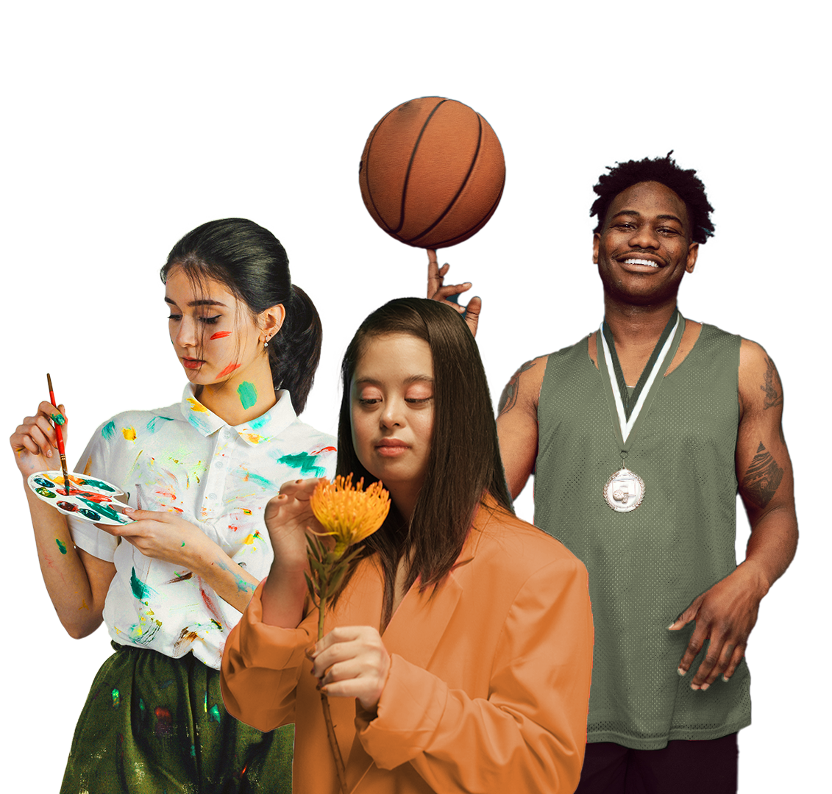
COMPANY PROFILE
All rights reserved to Gaia international association

Slide 2
ABOUT US
Gaia is a term from Greek methodology that means “mother earth”. Earth is our planet our global home. In Gaia, we believe that home is for everyone. GAIA believes everyone has the right to participate in sports and artistic activities, regardless of their abilities. Our programs are designed to help individuals with disabilities build their confidence and develop their skills, while also increasing awareness and understanding of disability issues within the wider community. Through their work, GAIA is helping to foster a more inclusive society where everyone has the opportunity to participate and thrive.
All rights reserved to Gaia international association

Slide 3
Vision
The association was established with the aim of promoting and developing sports and artistic performances such as drama, audio-visual, films, dance, music, and various literatures with a multiplicity of disciplines and to achieve cooperation between healthy artists and athletes, including people of determination, as well as integrating people of determination in local and international arts and sports works in cooperation with local, Arab and international artists and athletes.
All rights reserved to Gaia international association

Slide 4
Mission
Advance cutting-edge sports and Arts-specific research, educate current and future sports and Arts professionals, improve the physical and emotional lives of current and former athletes, and harness the power of sport and Arts to inspire positive social change
All rights reserved to Gaia international association

Slide 5
What we do?
Planning, work, and mutual cooperation between artists All of them working in the fields, whether cultural or artistic, at the level of healthy people and people of determination.
Planning, working, and cooperating to develop sports fields and athletes from all over, internationals, as well as organizing courses athletes inside and outside for healthy athletes and people of determination.
Organizing sporting events in all their aspects, whether tournaments, or cooperation protocols for the development of clubs, ministries, and companies, whether internally or externally.
Organizing cultural events, theatrical performances, films, art exhibitions, contemporary music, and lectures international cultural for healthy people and people of determination, and distinguishing between events.
Planning and preparing sports programs, vocational and technical training for people of determination from all the countries for the purpose of their integration.
All rights reserved to Gaia international association

Slide 6
Encouraging international artistic production, especially artistic production for people and artists of determination.
Spreading efficiency in the hope of facilitating the full harvest of our goals.
Developing and strengthening cooperation with artistic organizations in All the world, and by activating joint international relations in the following: Art, sports, and culture.
Entering into cooperation protocols with the concerned state institutions to exploit the energies of youth within the ministries in producing a sports artwork that complements the role of the state to pay attention to these aspects and to develop the individual and society financially, culturally, and athletically.
Creating a new environment within the state in terms of civility that manages, organizes, and contributes significantly to the production of a system that contributes to the role of the state in using the energies of youth in schools, universities, clubs, and companies, and delivering them in an official manner to the concerned ministries and entering into local, and international competitions that contribute significantly to the development of the roles of society distinguished by its leadership internationally.
Using the mother association based in Croatia within the European Union to ascend to the world through a new generation of healthy youth and people of determination.
All rights reserved to Gaia international association

Slide 7
Objectives
Promote and develop sports and artistic performances such as drama, audiovisual, film, dance, music, literature, and innovative arts Achieving harmony between healthy Croatian artists and people of determination and integrating people of determination into art and sports at the local and international levels - cooperation of artists and workers in this field.
Activities related to arts, sports, and human rights Planning, working, and mutual cooperation between Croatian artists and attracting them in many fields, whether cultural or artistic, healthy and people of determination. Planning and working on the development of sports fields.
All rights reserved to Gaia international association

Slide 8
Values
Creative Collaboration: We will seek connections across disciplines and will continually work together to seek out new and creative ways to solve the issues and challenges that face the sports and arts industry.
Responsibility: We will never forget our responsibility to care for athletes and artists and improve their physical and emotional well-being.
Open Dialogue: We will be a forum the free exchange of ideas so that all have the voice to propose solutions to problems facing the sports industry and society at large.
Empowerment: We will work with artists and athletes and give them the tools and skills necessary to improve the lives of others.
Passion: We will approach our work with the same passion that athletes have for achieving their goals and fans have for supporting their teams.
“Sport and art has the power to change the world. It has the power to inspire. It has the power to unite people in a way that little else does. It speaks to youth in a language they
understand. Sport and art can create hope where once there was only despair.
All rights reserved to Gaia international association

Slide 9
High board
Activities related to arts, sports and human rights Planning, work and cooperation between artists and attracting them in many fields, whether cultural, artistic or sports, including people of determination. And planning and working to develop sports stadiums, theaters, cinemas and manual artwork
All rights reserved to Gaia international association

Slide 10
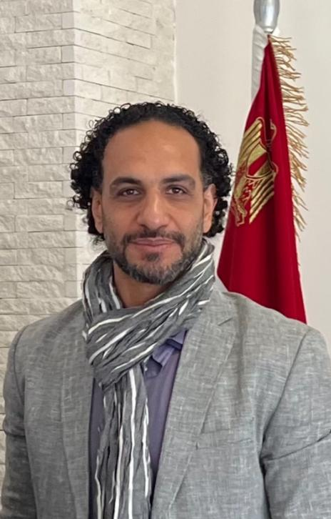
Chairman Speech And Founder
A society that appreciates the value of its sons and daughters with special needs, especially the outstanding and the heroes among them, raises their status, values their achievements, and works to empower them and integrate them in all aspects of life. As part of continuing efforts to enhance community participation for people with special needs
Gaia is here today to give more support to our heroes in many fields and develop cooperation between art And sports all over the world.
All rights reserved to Gaia international association

Slide 11
Partners
All rights reserved to Gaia international association

Slide 12
Thank You
All rights reserved to Gaia international association

