Slide 1
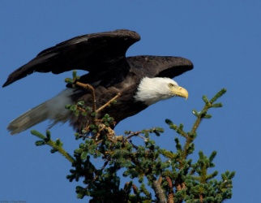
Association Nesser for Agriculture and Development
ANAD
The E Association Nesser for Agriculture and Development is a non-governmental, non-political, non-profit organization created under Law No. 64/098 of Mauritania of associations issued on June 09, 1964 under Receipt No. 0171 dated 07/13/2011 and its main headquarters is in Nouakchott and operates in all regions of the country
It seeks to achieve its goals by following a participatory approach that focuses on the beneficiaries and cooperates with the various actors and partners.

Slide 2
General goals :
• Organizing and participating in any action (national, regional or international) aimed at preserving the environment and sustainable development.
• Participating in reaching the goals of sustainable development 2030 through the development of agricultural projects and the formation of international and local alliances. in the field of sustainable development
• Fighting desertification by planting trees
• Support initiatives aimed at preserving the environment in general.
* Establishing agricultural projects in order to support food security
* Supporting agricultural women's cooperatives
Combating malnutrition for children between 6 months and 59 months
Tree protection

Slide 3
Strategies:
• Revitalizing Al-Nisr Association for Agriculture and Development, asking the public authorities to apply legal texts and international agreements related to environmental protection and preservation.
• Improving the living conditions of the population.
Fighting poverty
Work on adapting to climatic changes and resilience

Slide 4
projects
The project is to improve community resilience and food security in the face of the adverse effects of climate change in Mauritania. It is implemented in partnership with the PARSACC World Food Program.
The area that intervenes in the project is the state of trarza, the province of Medrara, in southern Mauritania
The following different areas and activities according to the project components
.Component 1, relates to support in the following areas:
Educating the beneficiary communities and municipalities in the following areas
The challenges of climate change on natural resources, communities' livelihoods and food security,
Ownership of project activities
sustainability of the activities
b Mobilizing communities in the following areas
Support the organization of communities into village management committees and the creation of community dynamics
Supporting the formation of village management committees in the form of structures that are representative and legally recognized by local authorities and authorities
(representative and simplified organization)
Mobilize beneficiaries to implement each activity maintained in the Adaptation Action Plans
Activate communities to participate in rural radio broadcasting in cooperation with local antennas

Slide 5
Activities:
Reforestation: 75,000 trees have been planted
200 hectares of sand have been installed
Reserves 100 hectares have been fenced off
Component 3, support relates to the following areas
Cultivation of fruit trees Five hectares have been cultivated
- Poultry farming Five farms have been opened to produce local poultry
240 Promotion des foyers améliorés were produced
2 modern poultry farms and 1 shop were opened, and 3 women's cooperatives were supported to manufacture couscous (AGR) A- Income-generating activities

Slide 6
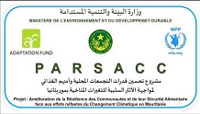
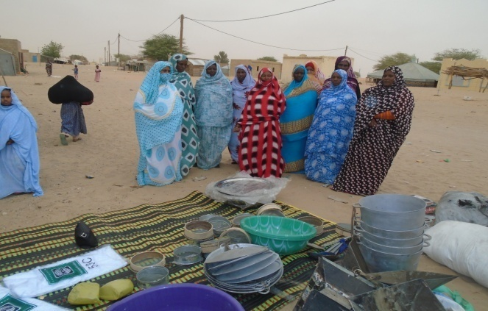
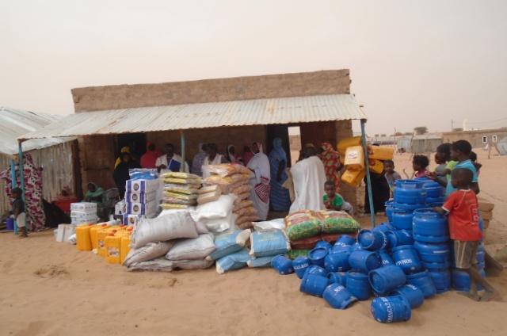
Image from project activities
LES AGR
LES AGR

Slide 7
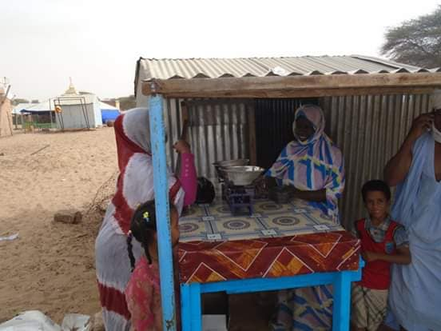
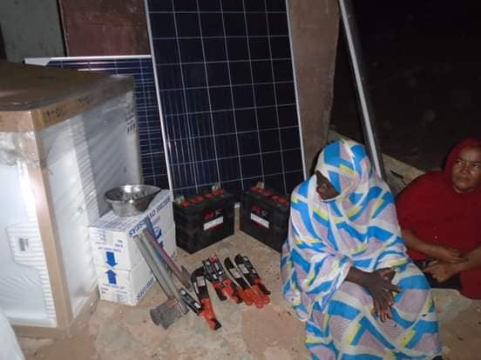

Slide 8
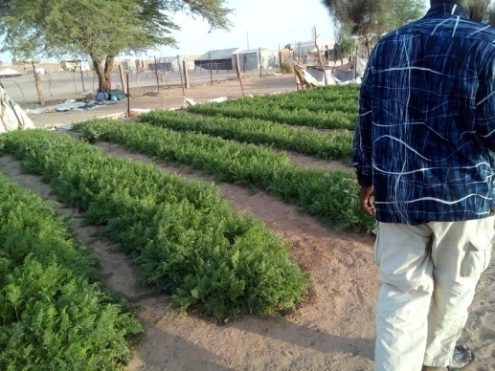
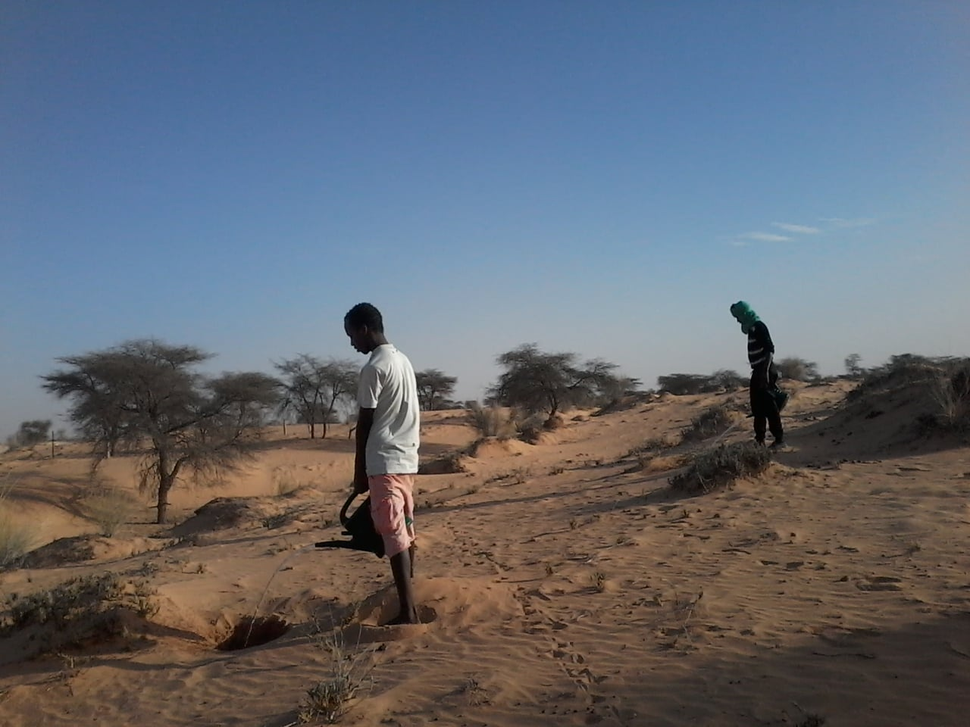
Reboisement
Pépinière
Reboisement
Reboisement

Slide 9
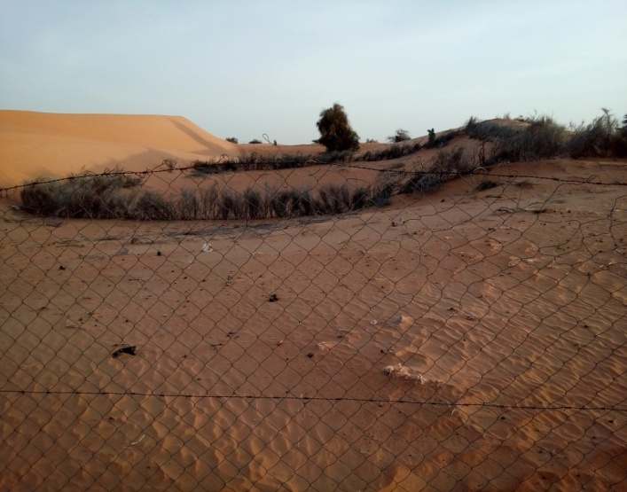
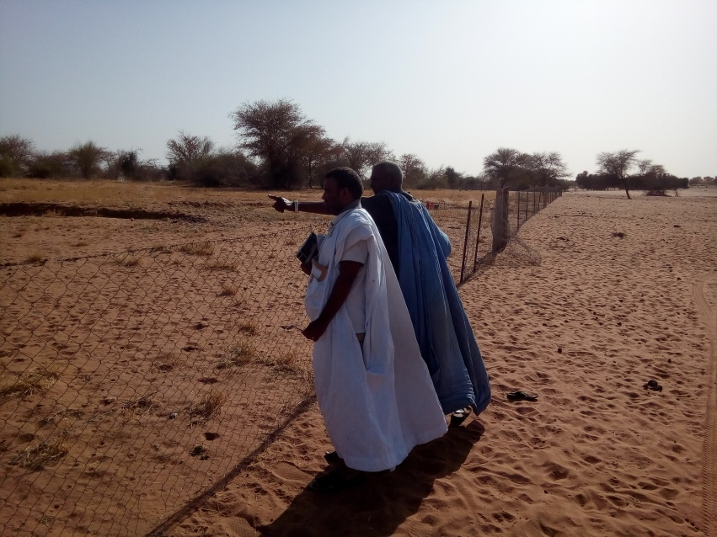
Fixation des dunes
:
Mises en défens

Slide 10
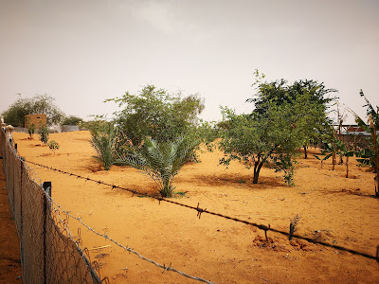
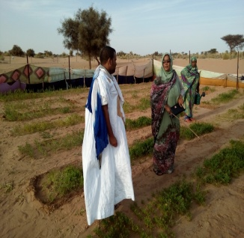
Maraichage
Arboriculture fruitière

Slide 11
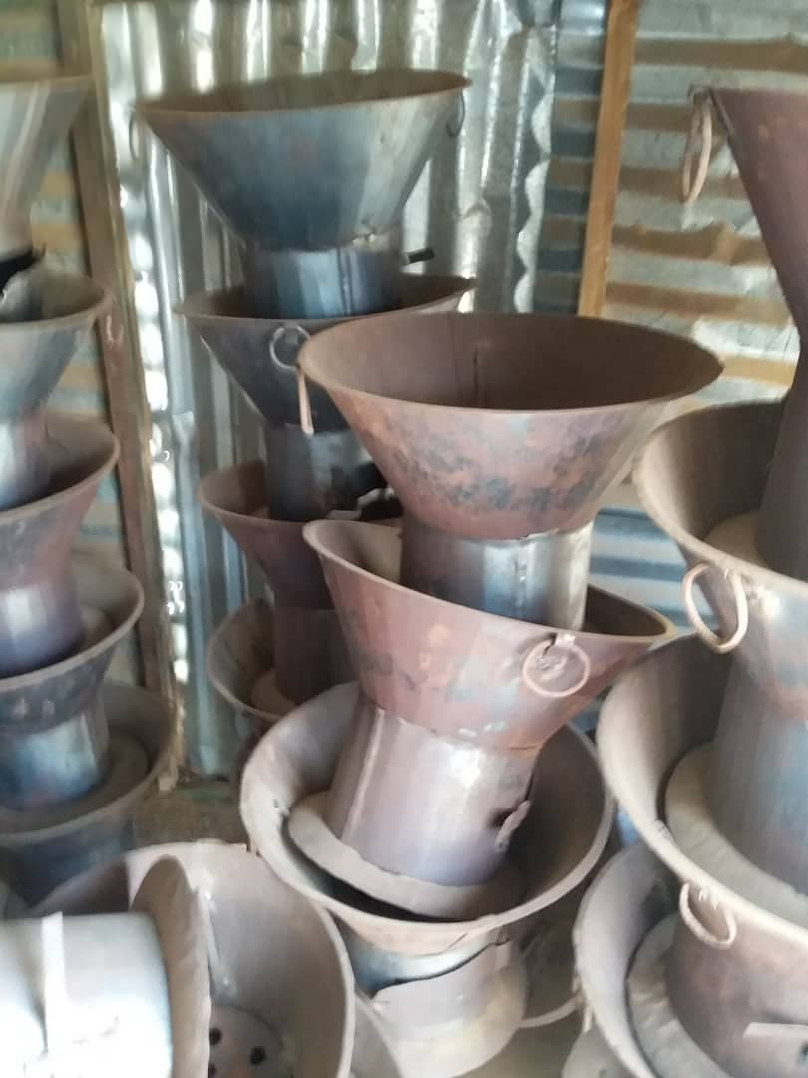
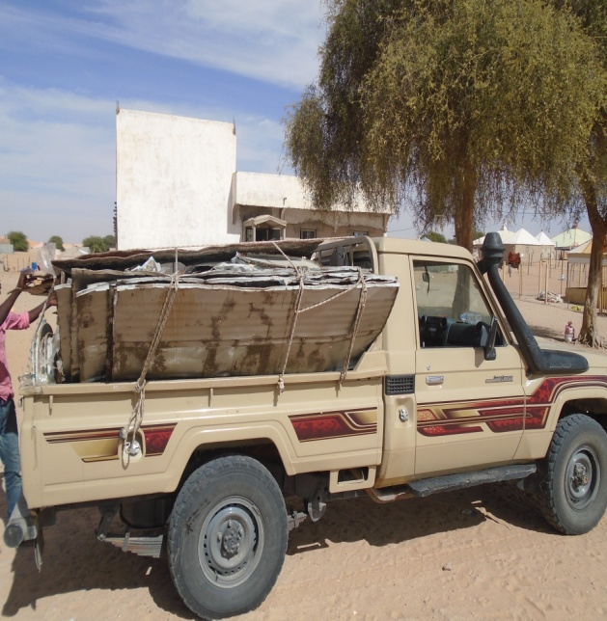
Promotion des foyers améliorés

Slide 12
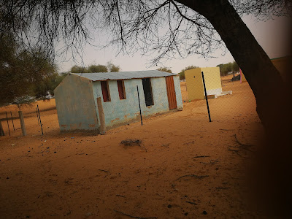
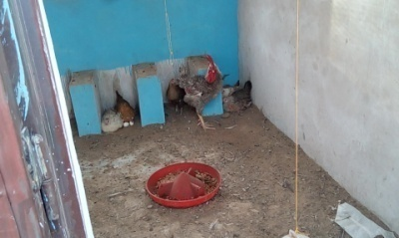
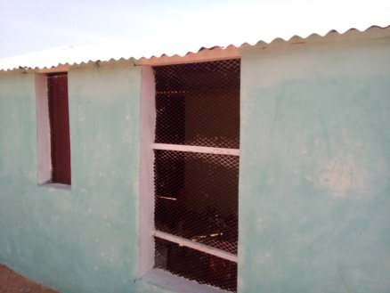
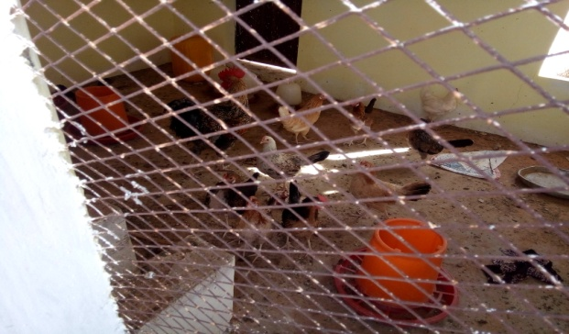

Slide 13
-
The second project
A project to combat malnutrition in vulnerable areas in the state of taraza in the province of Kermescien from 2014 to 2016 in partnership with UNICEF
Project goals
First - the general objective:
- Improve community nutrition in the project area, by 2020
secondly. Specific goals:
- Improving community nutrition interventions and the nutritional status of the mother and her child in the project area
Promote healthy eating habits and behaviours.
Establishment of agricultural projects for cooperatives formed by mothers of malnourished children

Slide 14
Project results
80% of children under five years of age residing in the districts of Roseau and Kremsen were screened and referred to institutions
90 per cent of severely malnourished children in Kremsin district benefited from home monitoring
85 percent of parents of children under 5 know at least 4 family practices essential to child survival and 30 percent have adopted at least two
12 agricultural cooperatives have been established for women whose children are malnourished

Slide 15
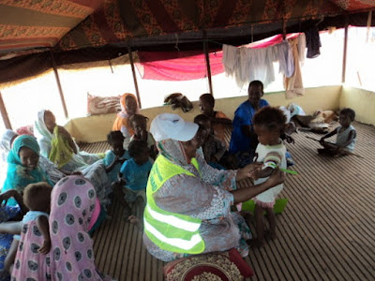
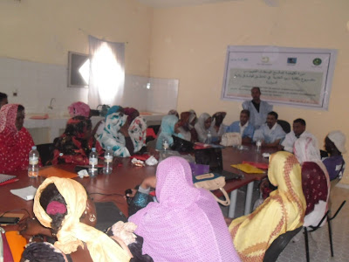
Image from project activities

Slide 16
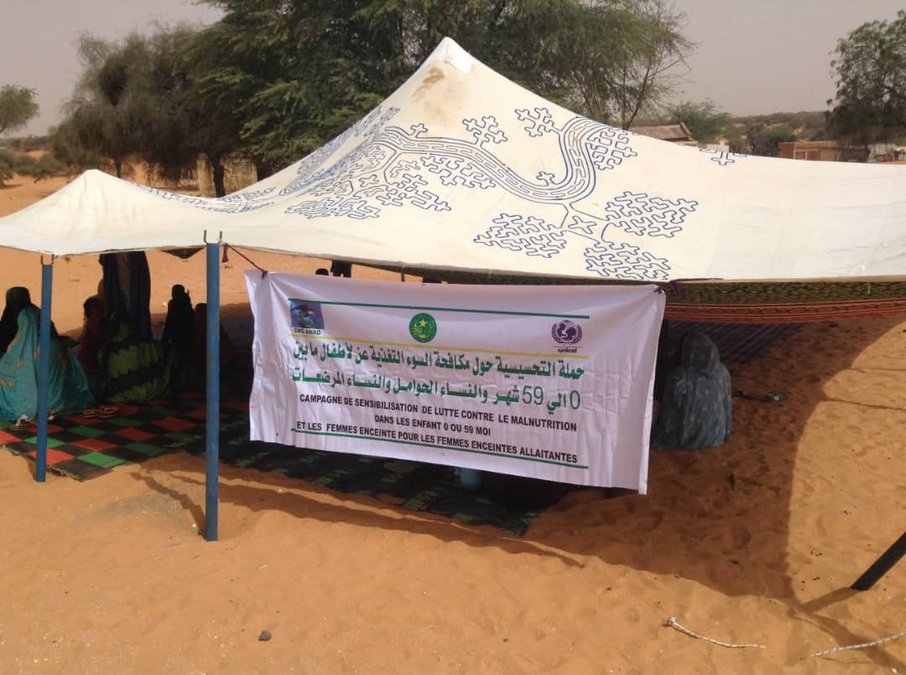

Slide 17
Networking Partners
Partners
UNICIF
PAM
PNUD
FAO
CNLA
GTAI
UNDDR
Networking
CNAW
GNDR
SEM
شبكة شمال افريقيا لسيادة الغذائية
ANYL4PSD
GF MENA PLATFROM
RONACED
GEF
RACCC ARICANES

Slide 18
Means of Communication
Site https:associationanad.blogspot.com
s://www.facebook.com/AssociationANAD?mibextid=ZbWKwL
Thank you
Merci
شكرا
TEL 0022236873587
0022249873587
Mail dah_cnla@yahoo.fr

